Slide 1
Work Stealing Dequeue
By:
Jatin Sachdeva (CS19B1013)
Abhijeet Wankhade (CS19B1028)

Slide 2
Introduction
Need of Work Distribution Algorithm
Simple Approach Work Dealing
Flaw in Work Dealing

Slide 3
Work Stealing
A thread tries to steal task only when it runs out of its own tasks.
A thread steals a task by choosing a random victim from the other available threads.
Busy threads doesn’t waste time to offload work.

Slide 4
Yielding
Multiprogramming Environment
Threads should guarantee progress.
Threads that have work should not be delayed by thief thread
Thief Should call Thread.yield( ) before stealing task.
no effect if there are no descheduled threads capable of running.

Slide 5
Work Stealing Dequeues
Each thread keeps the pool of tasks waiting to be executed in a dequeue.
Dequeue provide three methods
pushBottom( )
popTop( )
popBottom( )
Weaker constraints on Wait Free
Common case pushBottom( ) & popBottom( )
Uncommon case popTop( )
Optimize the common case
Two Types of Dequeue:
Bounded Dequeue
Unbounded Dequeue

Slide 6
Bounded Work Stealing Dequeue
Consists of array of runnable tasks in a double ended queue.
Need to know the capacity of dequeue beforehand.
This class has 3 fields: tasks, bottom, and top.
Top field holds Stamped Reference.
The stamp is needed to avoid an “ABA” problem.

Slide 7
ABA Problem Example
1] popTop() on 3 by Thread A
2] popBottom() 3 times
Top
Top
0 1 2 3 4 5
0 1 2 3 4 5
3] pushBottom() 5 tasks
4] 3 times popTop() by thread B
Top
Top
0 1 2 3 4 5
0 1 2 3 4 5

Slide 8
pushBottom( )
Stores the new task at the bottom queue location and increments the bottom field.
void pushBottom(RunnableTask *task) { tasks[bottom] = task; bottom++; }

Slide 9
popBottom( )
If the queue is empty, the method returns immediately, otherwise, it decrements bottom, claiming a task.
Bottom field must be declared volatile to make sure thieves can recognize an empty Bounded DEQueue.
When only one task left, we use compareAndSet() to resolve conflict between a thief and popBottom().
If compareAndSet() succeeds then top reset to 0 and task has been claimed.
If compareAndSet() fails that means thief succeeded.

Slide 10
RunnableTask popBottom() { if(bottom == 0) return nullptr; bottom--; RunnableTask *r = tasks[bottom]; StampedReference<int> oldTop = top->load(); StampedReference<int> newTop(0, oldTop.stamp+1); if (bottom > oldTop.value) return r; if(bottom == oldTop.value){ bottom = 0; if (top->compare_exchange_strong(oldTop, newTop)) return r; } top->store(newTop); return nullptr; }

Slide 11
popTop( )
Checks if the queue is empty. If it is then returns null.
If not then tries to steal the top task by calling compareAndSet().
If compareAndSet() succeeds means thief has claimed the task otherwise it returns null.
Method is nondeterministic as this method returning null does not necessarily means that the queue is empty.

Slide 12
RunnableTask* popTop() { StampedReference<int> oldTop = top->load(); StampedReference<int> newTop(oldTop.value+1, oldTop.stamp+1); if(bottom <= oldTop.value) return nullptr; RunnableTask *r = tasks[oldTop.value]; if (top->compare_exchange_strong(oldTop, newTop)) return r; return nullptr; }

Slide 13
isEmpty()
This method simply used to check whether dequeue is empty or not. To check whether the dequeue is empty or not it simply checks bottom <= top.
bool isEmpty() { int localTop = top->load().value; int localBottom = bottom; return (localTop < localBottom); }

Slide 14
Unbounded Work Stealing Dequeue
Dynamically resizes if needed
Implemented as cyclic array with top and bottom field
Bottom <= top means dequeue is empty
Using cyclic array eliminates the need to reset top & bottom = 0
Top is always incremented so ABA problem cannot occurred
No need for the top to be AtomicStampedReference

Slide 15
pushBottom( )
Push the task in circular array and increments the bottom field
Resizes the circular array when it become full
Linearization point is when bottom is incremented

Slide 16
Pseudo code of pushBottom( )
public void pushBottom(Runnable r) { int oldBottom = bottom; int oldTop = top.get(); CircularArray currentTasks = tasks; int size = oldBottom - oldTop; if (size >= currentTasks.capacity()-1) { currentTasks = currentTasks.resize(oldBottom, oldTop); tasks = currentTasks; } tasks.put(oldBottom, r); bottom = oldBottom + 1; }

Slide 17
popBottom( )
Decrement the bottom & check the size of the dequeue
If empty( i.e size < 0 ) simply return null
If size = 0,i.e there is one task in the dequeue. pushBottom( ) & popTop( ) can try to get the same task.
Calling thread switches to compare & swap on top field
If compare & swap return true, means thread succeeded and it will return the task.
If compare & swap return false, means thief succeeded and it will return null
Whether it succeed or fails top will be incremented so it will sets the bottom = top + 1
Linearization point when bottom is decremented

Slide 18
Pseudo code of popBottom( )
public Runnable popBottom() { CircularArray currentTasks = tasks; bottom--; int oldTop = top.get(); int newTop = oldTop + 1; int size = bottom - oldTop; if (size < 0) { bottom = oldTop; return null; } Runnable r = tasks.get(bottom); if (size > 0) return r; if (!top.compareAndSet(oldTop, newTop)) r = null; bottom = oldTop + 1; return r; }

Slide 19
popTop( )
First checks the size of dequeue
Size <= 0, it simply returns null
Size < 0 means dequeue was empty
Size = 0 means dequeue was empty or there was only one task in the dequeue and concurrent popBottom method has already decremented bottom.
Else tries to steal the task using compare & swap on top field
If compare & swap succeeded return the task else return null
Linearization point for successful popTop( ) when compare & swap succeed
Linearization point for unsuccessful popTop( ) when it discovers dequeue is empty or at failed compare & swap

Slide 20
Pseudo code for popTop( )
public Runnable popTop() { int oldTop = top.get(); int newTop = oldTop + 1; int oldBottom = bottom; CircularArray currentTasks = tasks; int size = oldBottom - oldTop; if (size <= 0) return null; Runnable r = tasks.get(oldTop); if (top.compareAndSet(oldTop, newTop)) return r; return null; }

Slide 21
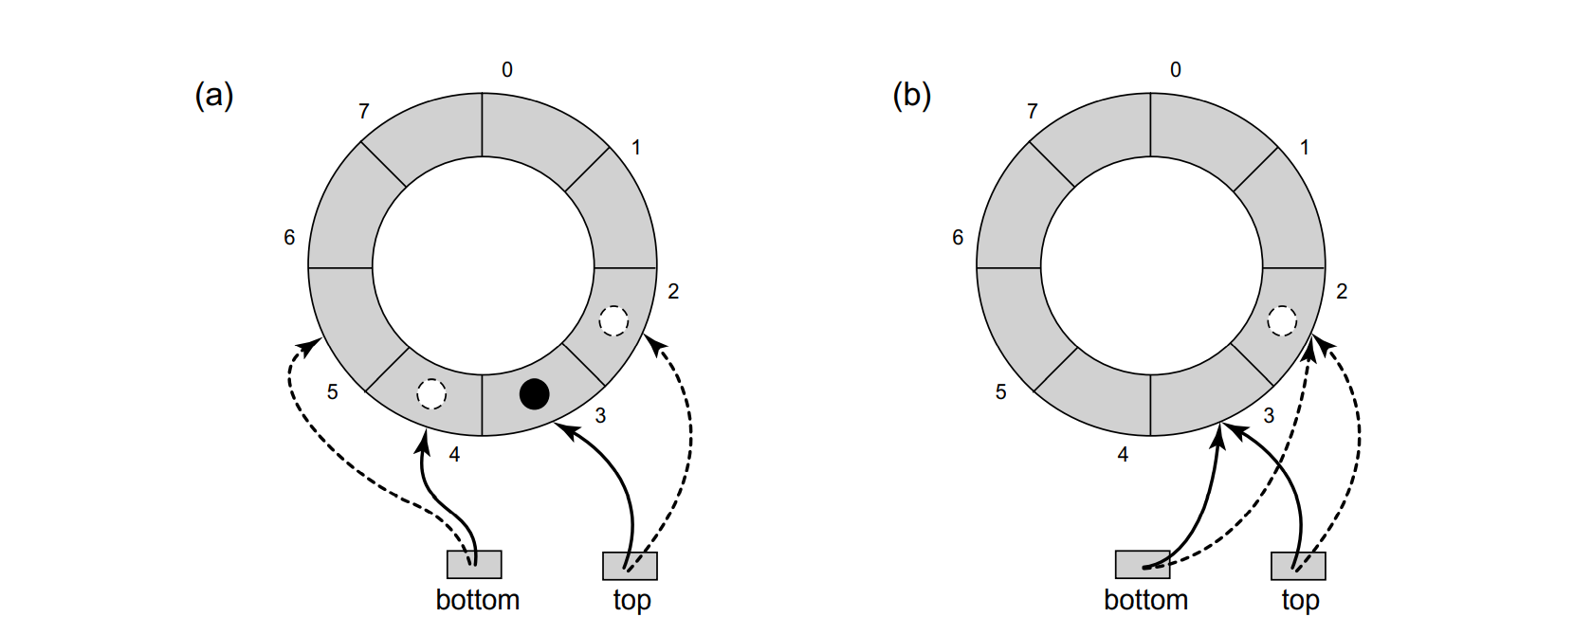

Slide 22
Application
Check Prime Number
Matrix multiplication

Slide 23
Check Prime Number
Takes an input n and number of threads.
Check prime for all the number in the range 1 to n.
It divides the task equally among all the thread except the last thread which will also take the remaining task
Pushed the task in the dequeue exponentially
After finishing its task thread will try to steal task from other threads.
It will try only number of threads - 1 times

Slide 24
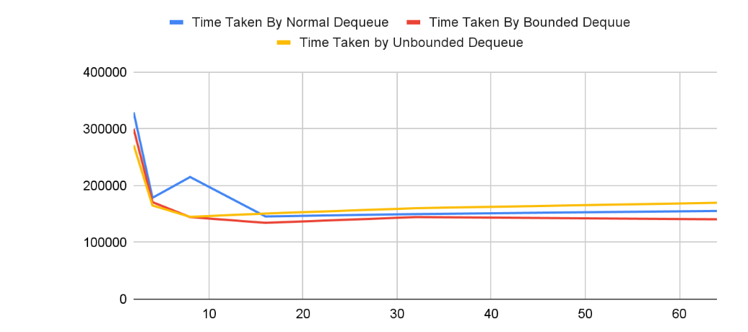
Time Taken in Microseconds by Number of Threads To Check Prime Upto 10^6

Slide 25
Matrix Multiplication
Compute matrix multiplication parallely.
Fixed number of threads equal to 4.
n * m tasks are created for multiplication result of size n * m
Task is distributed randomly among four threads
This will make some threads overloaded and some threads lightly loaded.
Lightly loaded thread will help overloaded thread after finishing it task

Slide 26
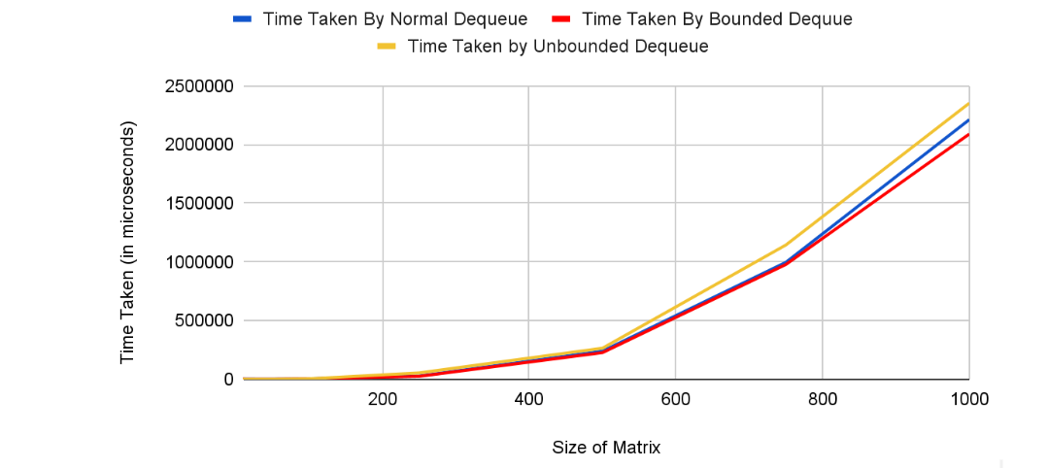
Matrix Size vs Time taken

Slide 27
Thank You

